Slide 1

Introduction to Docker (with Windows)

Slide 2

Philip Nelson
Stone Porch Consulting
github.com/panmanphil
twitter.com/panmanphil
panmanphil.wordpress.com
Introduction to Docker

Slide 3
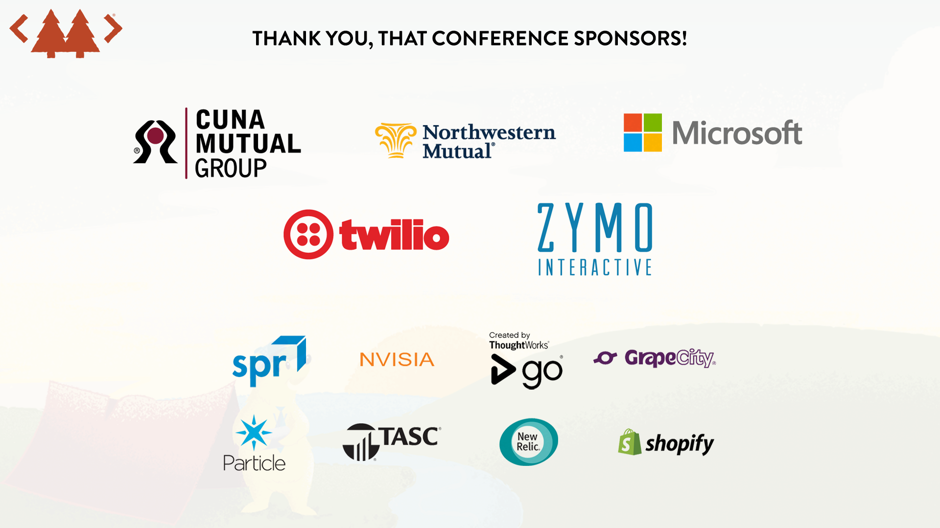

Slide 4


agenda
What is Docker
And on Windows?
Common developer workflows
Ask your questions
Notes:
Overview of what docker is
How docker runs on windows 7/10/2016
Using docker for development
Of course questions

Slide 5

A new way to run apps
I run on your computer
I run on your computer …
Docker apps
Notes:
Talk about this, and then say let’s see how we’d run a zip file

Slide 6

Apps are isolated from each other
And the apps are background only, NO GUI
This box in mine all mine!!
This box in mine all mine!!
Docker apps
Notes:
Talk about this, and then say let’s see how we’d run a zip file

Slide 7
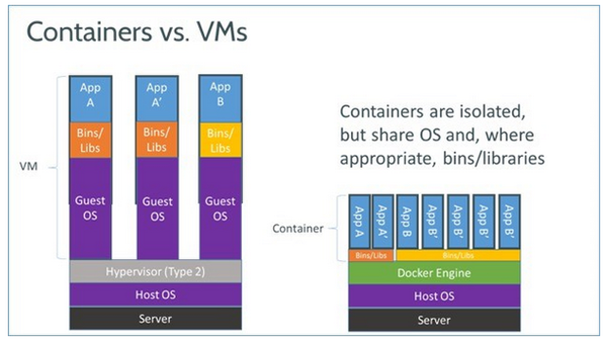

Slide 8
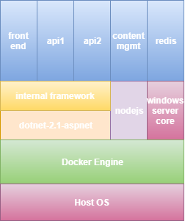

He lies … there is a VM

Slide 9
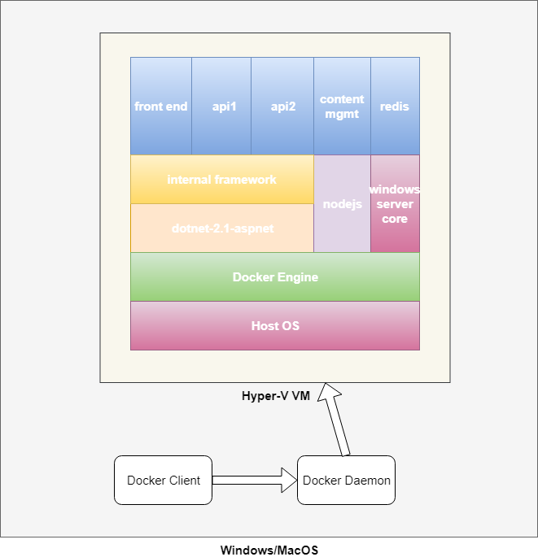

Slide 10
Windows 10
Windows 2016
Mac OS
Containers run in VM (hyperv)
nanoserver containers
< 1GB .net core only
windowservercore containers
most windows apps > 13 GB
Linux containers
< 100MB **
Linux containers in Windows **
Containers CAN run native
nanoserver containers - < 1GB .net core only
windowservercore containers – most windows apps > 13 GB
Containers run in VM (hypervisor)
Linux apps - < 100MB
Linux
Containers run native
Linux apps - < 100MB

Slide 11

Docker is like a zip file
Stuff a piece of software in there and you’re good to go
Notes:
Talk about this, and then say let’s see how we’d run a zip file

Slide 12

Docker is like a zip file
Stuff a piece of software in there and you’re good to go
docker run –d tasty-app
Notes:
We can tell docker to run something, but not a zip file.
What does an application need to run?

Slide 13
Running a program in a zip file
Add the program to the zip….
Wait, what?
Notes:
An application needs disk IO, memory, network, cpu. Zip doesn’t have it!

Slide 14
Running a program in a zip file
In docker:
The zip file is an image
When you run an program in an image, you are creating a container from the image

Slide 15

A Container is Prison for apps
I live in here
Notes:
Running in the container, the app can see only the files in the container you packaged with it and any resources you pass in at run time.
Well also the kernel (linux or windows) resources your software libraries have access to
How do we get files into the image

Slide 16
Running a program in a zip file
Stuffing a program in the zip =
docker build –t tasty-image .
Notes:
You saw docker run ….

Slide 17
Running a program in a docker image
docker run tasty-image
Uhhh … there’s more to it than that

Slide 18
Building with Dockerfiles
The minimal base set of files
FROM microsoft/nanoserver
ADD ./bin/debug/netcoreapp2.1/* ./
Source file(s)
Destination inside the image

Slide 19
Running a program in a docker image
docker run tasty-image dotnet tasty-app.dll
Do I really have to type all that?

Slide 20
Building with Dockerfiles
FROM microsoft/dotnet:2.1-runtime
ADD ./bin/debug/netcoreapp2.1/publish/ ./
CMD [“dotnet”, “tasty-app.dll”]
Adds a default command to run when a container starts

Slide 21
Building with Dockerfiles
FROM microsoft/<base image with most of what you need>
# all your build commands including pulling real zip files from remote sites, running commands
# the default command to run
CMD [“dotnet”, “tasty-app.dll”]

Slide 22
Running a container from a docker image
docker run –it tasty-image
Interactive (i) with a tty (t)

Slide 23
Developer Workflows
Create an image from existing binaries
Build an image from source files
Live edit files in container
Multi-container system simulating production environment
Packaged tooling pipeline
Supporting old versions

Slide 24
Developer Workflows
Demo - Create an image from existing binaries
(basically what we’ve been doing)

Slide 25
Developer Workflows
Demo - Build an image from source files

Slide 26
Developer Workflows
Demo - Live edit files in container

Slide 27
Containers - Volumes
Data will stay with a running container ONLY when it is defined, running or stopped
Volumes define how data is stored and shared between the container and the host
Share files between host (your windows box) and container while it runs
Named volumes live independently of the container
volumes on the host can bee seen from the host OS (File explorer)

Slide 28
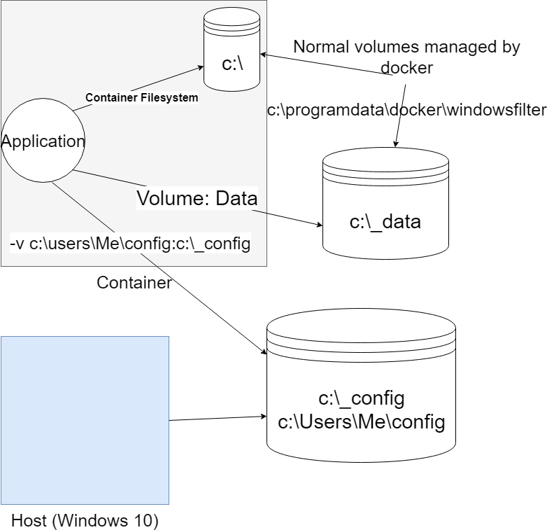

Slide 29
Containers - Volumes
Windows has some limitations for host mapped volumes
Must map to an existing EMPTY folder
The host folder must be on a disk, not a network folder
Access permissions can be an issue on the server

Slide 30
Developer Workflows
Packaged tooling pipeline

Slide 31

Our perfect developer box
We build the box, we install to it and life is good

Slide 32
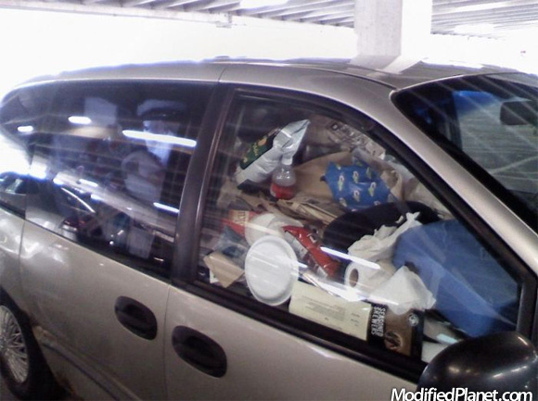
+ 1 year

Slide 33
Containers vs installs
Your host system remains much cleaner
Multiple versions of the same software are not a problem
Unless you keep files with volumes, removing the containers and image deletes everything from your system
Docker supports pruning unused containers, images and volumes

Slide 34
Containers - Running
You run with an image:
docker run –d yourregistryname/yourimage
Map ports to the host ports
docker run –d someimage –p 80:8080
Use volumes to persist data between different versions of the image
docker run –d someimage –v /var/run/mysql:/home/ec2user/mysql

Slide 35
Containers - Troubleshooting
docker inspect <name> shows the entire configuration of the container
docker logs <name> dumps system logs from within container
docker ps or docker ps –a to see running and not running containers
docker images – lists all of the disk images that make up all your containers
docker exec –t <name> powershell log into a running container

Slide 36
Containers – Good News
Startup speed
Deployment is part of development – build images, run images, setup networking and data
Much easier to prototype with different new technologies
Systems are much easier to establish with different dependencies: versions of infrastructure, legacy considerations, frameworks, languages are all isolated
Scale out is considerably easier (with other tools like ECS, Kubernetes)
Your dev computer doesn’t get buried in unused junk demanding repaves
Operations can focus just on cpu, disk storage, instances, networking boundaries
Dev works connections between containers, logical storage options that will still work on large scale
Everything is scripted, no manual “setup docs” required
Disaster recovery is much much easier to setup

Slide 37
Containers – The Bad News
Linux containers are definitely a WIP on Windows 10
LCOWs is still experimental though very promising
It is possible to set all this up with script, but it is still operations! Networks, file systems, and especially PERMISSIONS
This is a fast moving space, change is constant, keeping up is an effort
Many of the prebuilt repositories out there are of the “Some guy with a day to hack” variety, not well thought through, just works in all situations
Managing your persistent data is more consistent between applications, but still a major PITA
Some software basically “consumes” and entire host anyway: vagrant/chef/cloudformation may be a better option in these cases except for your dev machne
Understanding where all the logs are is another PITA

Slide 38


Slide 39

Thanks! Philip Nelson github.com/panmanphil twitter.com/panmanphil panmanphil.wordpress.com All versions of this talk at https://github.com/panmanphil/introduction-to-docker

